Slide 1
Semantic Analysis
CS 671
February 5, 2008

Slide 2
The Compiler So Far
Lexical analysis
  Detects inputs with illegal tokens
    e.g.: main$ ();
Syntactic analysis
  Detects inputs with ill-formed parse trees
    e.g.: missing semicolons
Semantic analysis
  Last “front end” analysis phase
  Catches all remaining errors

Slide 3
Semantic Analysis
Source code
lexical errors
Lexical Analysis
tokens
syntax errors
Syntactic Analysis
AST
semantic errors
Semantic Analysis
AST’
Intermediate Code Gen

Slide 4
Beyond Syntax
What’s wrong with this code?
  (Note: it parses perfectly)
foo(int a, char * s){ … }
int bar() {
int f[3];
int i, j, k;
char *p;
float k;
foo(f[6], 10, j);
break;
i->val = 5;
j = i + k;
printf(“%s,%s.\n”,p,q);
goto label23;
}

Slide 5
Goals of a Semantic Analyzer
Compiler must do more than recognize whether a sentence belongs to the language…
• Find remaining errors that would make program invalid
    undefined variables, types
    type errors that can be caught statically
• Figure out useful information for later phases
    types of all expressions
    data layout
Terminology
Static checks – done by the compiler
Dynamic checks – done at run time

Slide 6
Kinds of Checks
Uniqueness checks
  Certain names must be unique
  Many languages require variable declarations
Flow-of-control checks
  Match control-flow operators with structures
  Example: break applies to innermost loop/switch
Type checks
  Check compatibility of operators and operands
  Logical checks
  Program is syntactically and semantically correct, but does not do the “correct” thing

Slide 7
Examples of Reported Errors
Undeclared identifier
Multiply declared identifier
Index out of bounds
Wrong number or types of args to call
Incompatible types for operation
Break statement outside switch/loop
Goto with no label

Slide 8
Program Checking
Why do we care?
Obvious:
  Report mistakes to programmer
  Avoid bugs: f[6] will cause a run-time failure
  Help programmer verify intent
How do these checks help compilers?
  Allocate right amount of space for variables
  Select right machine operations
  Proper implementation of control structures

Slide 9
Can We Catch Everything?
Try compiling this code:
void main()
{
int i=21, j=42;
printf(“Hello World\n”);
printf(“Hello World, N=%d\n”);
printf(“Hello World\n”, i, j);
printf(“Hello World, N=%d\n”);
printf(“Hello World, N=%d\n”);
}

Slide 10
Inlined TypeChecker and CodeGen
You could type check and generate code as part of semantic actions:
expr : expr PLUS expr {
if ($1.type == $3.type &&
($1.type == IntType ||
$1.type == RealType)) $$.type = $1.type
else error(“+ applied on wrong type!”);
GenerateAdd($1, $3, $$);
}

Slide 11
Problems
Difficult to read
Difficult to maintain
Compiler must analyze program in order parsed
Instead … we split up tasks

Slide 12
Compiler ‘main program’
void Compile() {
AST tree = Parser(program);
if (TypeCheck(tree))
IR ir =
GenIntermedCode(tree);
EmitCode(ir);
}
}
Compile
AST
Parser
getToken
readStream

Slide 13
Typical Semantic Errors
Multiple declarations: a variable should be declared (in the same scope) at most once
Undeclared variable: a variable should not be used before being declared
Type mismatch: type of the LHS of an assignment should match the type of the RHS
Wrong arguments: methods should be called with the right number and types of arguments

Slide 14
A Sample Semantic Analyzer
Works in two phases – traverses the AST created by the parser
For each scope in the program
  process the declarations
    add new entries to the symbol table and
    report any variables that are multiply declared
  process the statements
    find uses of undeclared variables, and
    update the "ID" nodes of the AST to point to the appropriate symbol-table entry.
Process all of the statements in the program again
  use the symbol-table information to determine the type of each expression, and to find type errors.

Slide 15
Scoping
In most languages, the same name can be declared multiple times
  if its declarations occur in different scopes, and/or
  involve different kinds of names
Java: can use same name for
  a class
  field of the class
  a method of the class
  a local variable of the method
    class Test {
    int Test;
    void Test( ) { double Test; }
  }

Slide 16
Scoping: Overloading
Java and C++ (but not in Pascal or C):
  can use the same name for more than one method
  as long as the number and/or types of parameters are unique
  int add(int a, int b);
  float add(float a, float b);

Slide 17
Scoping: General Rules
The scope rules of a language:
  Determine which declaration of a named object corresponds to each use of the object
  Scoping rules map uses of objects to their declarations
C++ and Java use static scoping:
  Mapping from uses to declarations at compile time
  C++ uses the "most closely nested" rule
    a use of variable x matches the declaration in the most closely enclosing scope
    such that the declaration precedes the use

Slide 18
Scope levels
Each function has two or more scopes:
  One for the function body
    Sometimes parameters are separate scope!
    (Not true in C)
void f( int k ) { // k is a parameter
int k = 0; // also a local variable
while (k) {
int k = 1; // another local var, in a loop
}
}
  Additional scopes in the function
    each for loop and
    each nested block (delimited by curly braces)

Slide 19
Checkpoint #1
  Match each use to its declaration, or say why it is a use of an undeclared variable.
int k=10, x=20;
void foo(int k) {
  int a = x; int x = k; int b = x;
  while (...) {
    int x;
    if (x == k) {
      int k, y;
      k = y = x;
    }
    if (x == k) { int x = y; }
  }
}

Slide 20
Dynamic Scoping
Not all languages use static scoping
Lisp, APL, and Snobol use dynamic scoping
Dynamic scoping:
  A use of a variable that has no corresponding declaration in the same function corresponds to the declaration in the most-recently-called still active function

Slide 21
Example
For example, consider the following code:
int i = 1;
void func() {
cout << i << endl;
}
int main () {
int i = 2;
func();
return 0;
}
If C++ used dynamic scoping, this would print out 2, not 1

Slide 22
Checkpoint #2
  Assuming that dynamic scoping is used, what is output by the following program?
void main() { int x = 0; f1(); g(); f2(); }
void f1() { int x = 10; g(); }
void f2() { int x = 20; f1(); g(); }
void g() { print(x); }

Slide 23
Keeping Track
Need a way to keep track of all identifier types in scope
{
int i, n = …;
for (i=0; i < n; i++)
boolean b= …
}
i → int
n → int
i → int
n → int
b → boolean
?

Slide 24
Symbol Tables
Purpose:
  keep track of names declared in the program
Symbol table entry:
  associates a name with a set of attributes, e.g.:
    kind of name (variable, class, field, method, …)
    type (int, float, …)
    nesting level
    mem location (where will it be found at runtime)
Functions:
Type Lookup(String id)
Void Add(String id, Type binding)
Bindings: name type pairs {a → string, b → int}

Slide 25
Environments
Represents a set of mappings in the symbol table
function f(a:int, b:int, c:int) =
( print_int(a+c);
let var j := a+b
var a := “hello”
in print(a); print_int(j)
end;
print_int(b)
)
σ0
σ1 = σ0 + a → int
Lookup
in σ1
σ2 = σ1 + j → int
σ1
σ0
Notes:
sigma

Slide 26
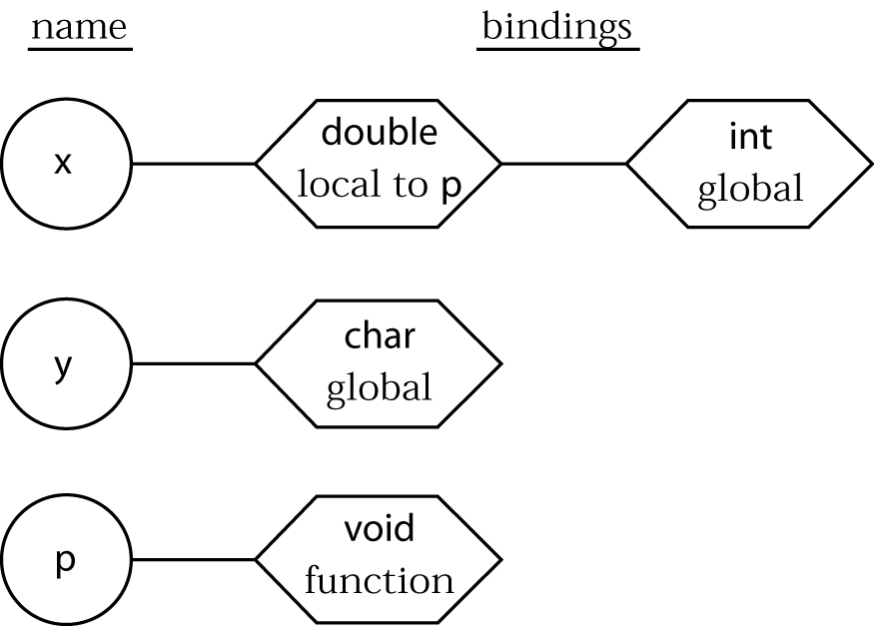
How Symbol Tables Work (1)
int x;
char y;
void p(void)
{ double x;
…
{ int y[10];
…
}
…
}
void q(void)
{ int y;
…
}
main()
{ char x;
…
}

Slide 27
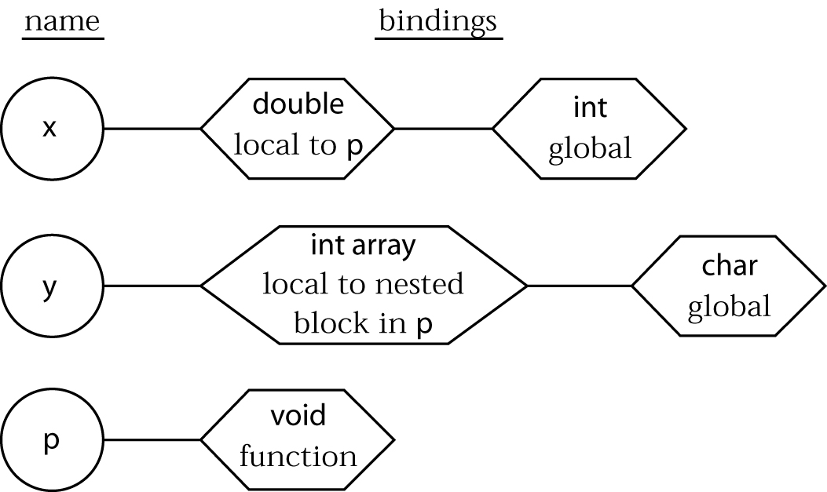
How Symbol Tables Work (2)
int x;
char y;
void p(void)
{ double x;
…
{ int y[10];
…
}
…
}
void q(void)
{ int y;
…
}
main()
{ char x;
…
}

Slide 28
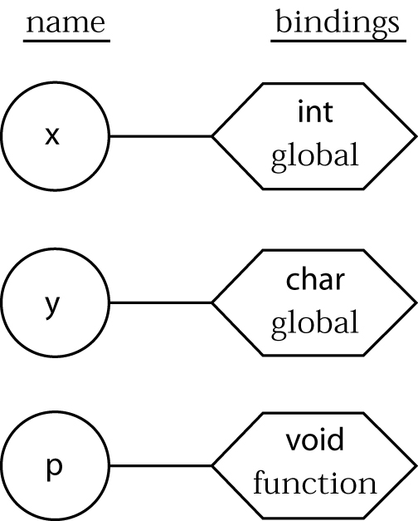
How Symbol Tables Work (3)
int x;
char y;
void p(void)
{ double x;
…
{ int y[10];
…
}
…
}
void q(void)
{ int y;
…
}
main()
{ char x;
…
}

Slide 29
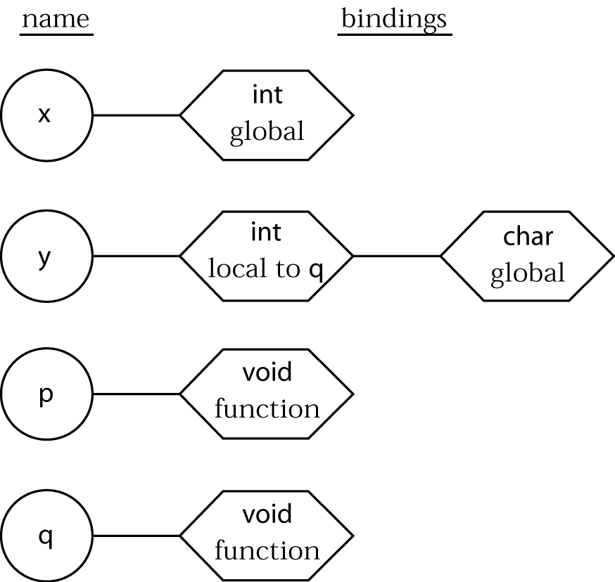
How Symbol Tables Work (4)
int x;
char y;
void p(void)
{ double x;
…
{ int y[10];
…
}
…
}
void q(void)
{ int y;
…
}
main()
{ char x;
…
}

Slide 30
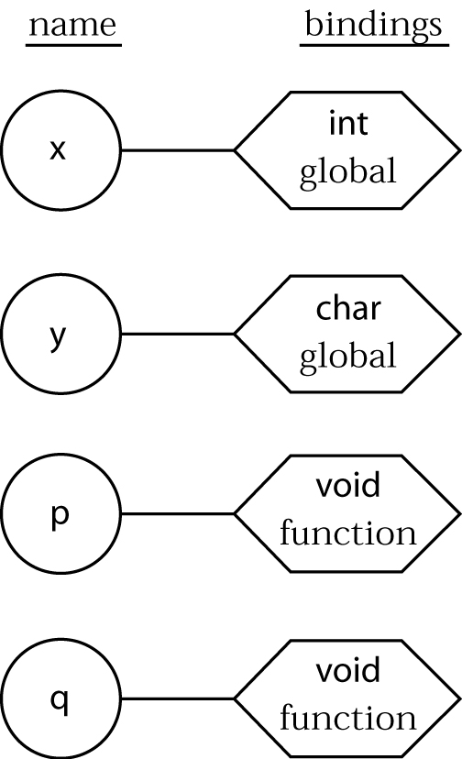
How Symbol Tables Work (5)
int x;
char y;
void p(void)
{ double x;
…
{ int y[10];
…
}
…
}
void q(void)
{ int y;
…
}
main()
{ char x;
…
}

Slide 31
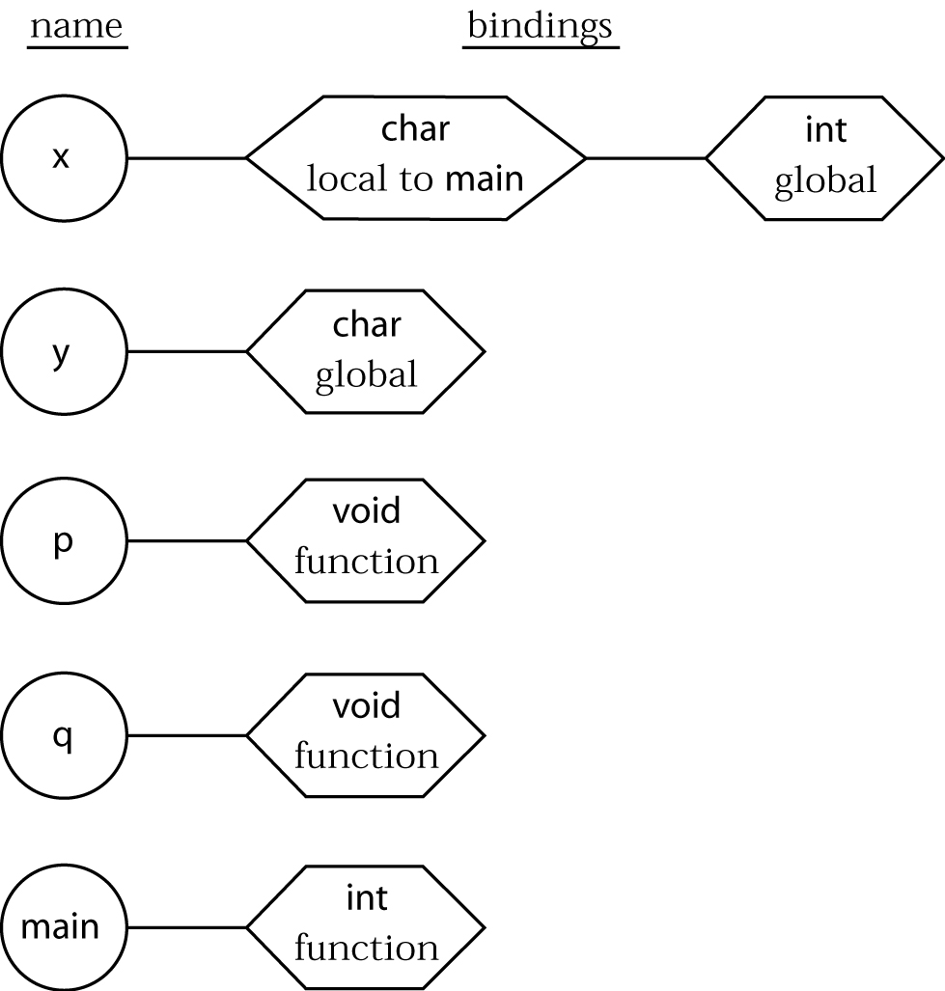
How Symbol Tables Work (6)
int x;
char y;
void p(void)
{ double x;
…
{ int y[10];
…
}
…
}
void q(void)
{ int y;
…
}
main()
{ char x;
…
}

Slide 32
A Symbol Table Implementation
Two structures: Hash table, Scope Stack
Symbol = foo
Hash(foo) = i
Symbol table
i
x
foo
bar

Slide 33
Enter/Exit Scope
We also need a stack to keep track of the “nesting level” as we traverse the tree…
a
\
a
y
\
x
Scope change
X
x
\
y
y
x
x
x

Slide 34
Variables vs. Types
Often, compilers maintain separate symbol tables for Types vs. Variables/Functions
Lecture Checkpoint:
✓ Scopes
→ Types

Slide 35
Types
What is a type?
  The notion varies from language to language
Consensus
  A set of values
  A set of operations allowed on those values
Certain operations are legal for each type
  It doesn’t make sense to add a function pointer and an integer in C
  It does make sense to add two integers
  But both have the same assembly language implementation!

Slide 36
Type Systems
A language’s type system specifies which operations are valid for which types
The goal of type checking is to ensure that operations are used with the correct types
  Enforces intended interpretation of values
Type systems provide a concise formalization of the semantic checking rules

Slide 37
Why Do We Need Type Systems?
Consider the assembly language fragment
addi $r1, $r2, $r3
What are the types of $r1, $r2, $r3?

Slide 38
Type Checking Overview
Four kinds of languages:
  Statically typed: All or almost all checking of types is done as part of compilation
  Dynamically typed: Almost all checking of types is done as part of program execution (no compiler) as in Perl, Ruby
  Mixed Model : Java
  Untyped: No type checking (machine code)

Slide 39
Type Checking and Type Inference
Type Checking is the process of verifying fully typed programs
    Given an operation and an operand of some type, determine whether the operation is allowed
Type Inference is the process of filling in missing type information
    Given the type of operands, determine
      the meaning of the operation
      the type of the operation
    OR, without variable declarations, infer type from the way the variable is used
The two are different, but are often used interchangeably

Slide 40
Issues in Typing
Does the language have a type system?
  Untyped languages (e.g. assembly) have no type system at all
When is typing performed?
  Static typing: At compile time
  Dynamic typing: At runtime
How strictly are the rules enforced?
  Strongly typed: No exceptions
  Weakly typed: With well-defined exceptions
Type equivalence & subtyping
  When are two types equivalent?
    What does "equivalent" mean anyway?
  When can one type replace another?

Slide 41
Components of a Type System
Built-in types
Rules for constructing new types
  Where do we store type information?
Rules for determining if two types are equivalent
Rules for inferring the types of expressions

Slide 42
Component: Built-in Types
Integer
  usual operations: standard arithmetic
Floating point
  usual operations: standard arithmetic
Character
  character set generally ordered lexicographically
  usual operations: (lexicographic) comparisons
Boolean
  usual operations: not, and, or, xor

Slide 43
Component: Type Constructors
Arrays
  array(I,T) denotes the type of an array with elements of type T, and index set I
  multidimensional arrays are just arrays where T is also an array
  operations: element access, array assignment, products
Strings
  bitstrings, character strings
  operations: concatenation, lexicographic comparison
Records (structs)
  Groups of multiple objects of different types where the elements are given specific names.

Slide 44
Component: Type Constructors
Pointers
  addresses
  operations: arithmetic, dereferencing, referencing
  issue: equivalency
Function types
  A function such as "int add(real, int)" has type real×int→int

Slide 45
Component: Type Equivalence
Name equivalence
  Types are equiv only when they have the same name
Structural equivalence
  Types are equiv when they have the same structure
Example
  C uses structural equivalence for structs and name equivalence for arrays/pointers

Slide 46
Component: Type Equivalence
Type Coercion
  If x is float, is x=3 acceptable?
    Disallow
    Allow and implicitly convert 3 to float
    "Allow" but require programmer to explicitly convert 3 to float
  What should be allowed?
    float to int ?
    int to float ?
    What if multiple coercions are possible?
      Consider 3 + "4" …

Slide 47

Formalizing Types: Rules of Inference
We have seen two examples of formal notation specifying parts of a compiler
  Regular expressions (for the lexer)
  Context-free grammars (for the parser)
The appropriate formalism for type checking is logical rules of inference
├ e₁ : int ├ e₂ : int
├ e₁ < e₂ : boolean

Slide 48
Semantic Analysis Summary
Compiler must do more than recognize whether a sentence belongs to the language
• Checks of all kinds
    undefined variables, types
    type errors that can be caught statically
• Store useful information for later phases
    types of all expressions

